Slide 1
CS 2212B
Introduction to Software Engineering
Kostas Kontogiannis
Lecture 1: Introduction (Chapter 1)

Slide 2
Introduction – Welcome
First of all, I wish you a very productive and enjoyable academic term!
Software Engineering is a course that requires work, but it will reward you not only with theoretical but also with hands-on knowledge in an area which is very much sought after and influences a myriad of applications which affect our every day life.
The objectives of this course are:
  To understand the basic principles, processes, techniques and tools for specifying, designing, implementing, testing, and maintaining software systems
  To apply these basic principles, processes, techniques and tools through an term-long project with incremental deliverables

Slide 3
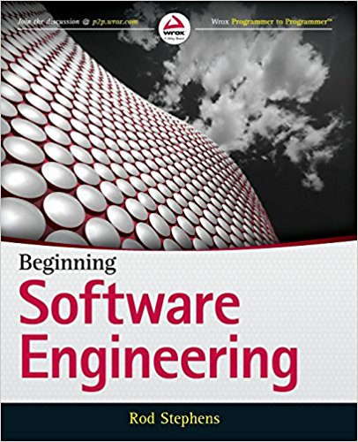
Textbook - Material
ISBN-13: 978-8126555376
ISBN-10: 8126555378
Wiley Publishers.
http://ca.wiley.com/WileyCDA/WileyTitle/productCd-1118969146.html
In addition to the text book, material will be shared via owl.
The OWL site will include files or provide references to course lecture material as well as links to relevant external resources and interesting tutorials.
You can use slack as your group collaboration tool. You can create your slack account at https://slack.com/. PLEASE NOTE: Slack is a collaboration tool for all of us to use in the class. You should exercise caution on the style and the tone of your writing. Offensive or judgmental comments to others should not be posted. Also, DO NOT SHARE IN ANY WAY PRIVATE INFORMATION ON SLACK CHANNELS. It is your responsibility to protect your private data from unauthorized access in this environment.

Slide 4
About the Instructor
Office: MC 375
E-mail: kostas@csd.uwo.ca
Tel. 519 661-2111 (ext. 84244)
Office hours: Wednesday 14:00 – 15:00 MC-375
Friday 13:00 – 15:00 MC-375
B.Sc. Applied Mathematics, U. Patras, Greece
M.Sc. Computer Science/AI, KUL, Belgium
Ph.D. Computer Science, McGill University, Canada
PostDoc Computer Science, U. Toronto, Canada
P.Eng. PEO – Software Engineering
Professor U. Waterloo, ECE (1997 – 2007)
NTUA, ECE (2007 – 2016)
Western, Comp. Sci. (2016 – ) – Western Research Chair

Slide 5
Research
Software Reverse Engineering and Maintenance
Cyber-Physical Systems
Services Computing
Intelligent Systems

Slide 6
Teaching Assistants
TBA: Monday 10:30 – 11:30 MC 220 (Tentative)
TBA: Tuesday 10:30 – 11:30 MC 220 (Tentative)
TBA: Wedn. 12:30 – 13:30 MC 220 (Tentative)
TBA: Thursday 13:30 – 14:30 MC 220 (Tentative)
TBA: Friday 14:30 – 15:30 MC 220 (Tentative)
TBA: Friday 15:30 – 17:30 MC220 (Tentative)
The e-mail to use for this course is: cs2212b@uwo.ca
Please allow for a week for TA hours to be sorted out.

Slide 7
Grading Plan and Project
Course project: 35%
Midterm: 25%
Final: 40%
Course project:
  Specify, design, and implement a system.
Teams of four students
Three project deliverables:
  Requirements specifications document
  Design document
  Implementation (includes unit testing)

Slide 8
Subject Material
Unit 1: Basic Software Engineering Concepts (Chapter 1)
Unit 2: Software Requirements (Chapter 4)
Unit 3: Fundamentals of the Unified Modeling Language (UML)
Unit 4: High Level Design – Architecture Styles (Chapter 5)
Unit 5: Key Design Patterns
Unit 6: Data Modeling (Chapter 6)
Unit 7: Quality Assurance and Testing (Chapter 8, and Chapter 10)
Unit 8: Software Reliability
Unit 9: Process Models, DevOps (Chapter 12, and Chapter 7)
Unit 10: Project Management (Chapters 3, 13, 14)

Slide 9
Chapter 1
Software Engineering from 20,000 Feet
Software and cathedrals are much the same. First we build them, then we pray.—Samuel Redwine
There are two ways of constructing a software design. One way is to make it so simple that there are obviously no deficiencies. The other way is to make it so complicated that there are no obvious deficiencies. The first method is far more difficult.—C.A.R. Hoare
Notes:
This lesson introduces the basic steps in a software engineering project at a high level.
In practice, steps often overlap.

Slide 10
What is Software Engineering ?
It is a area of Computer Science which relates to techniques, methods, practices and tools for the application of a systematic, disciplined, quantifiable approach to the development, operation, and maintenance of software; that is, the application of engineering to software.
The study of approaches as in (1) in order to develop high quality products within the specified budget and time.
[IEEE Standard 610.12]

Slide 11
Methods – Techniques – Tools
Method:
  a settled kind of procedure, usually according to a definite, established, logical, or systematic plan and formalism: the open-hearth method of making steel; one method of solving a problem.
Technique:
  the manner and ability with which an artist, writer, dancer, athlete, lawyer, or the like employs the technical skills of a particular art or field of endeavor so as to effect a desired result.
Methodology:
  A collection of techniques which are selectively applied throughout the phases of a project and are combined according to some practice or plan
Tools:
  Automated systems that apply a technique

Slide 12
Distinct and Complementary Roles
Computer Scientist
  Aims for providing theorems and properties of algorithms, designing new programming languages, defining new information modeling formalisms etc.
  A Computer Scientist usually has unlimited time to complete his/her task
Engineer
  Designs and oversees the implementation of a specific technical problem and project in a specific application domain
  An engineer uses computers, programming languages, techniques, and tools
Software Engineer
  Usually works on the design of software systems and oversees the implementation of a specific technical software projects in different application domains
  Has 3 months to design a solution ….
  …while user requirements and available technology constantly change … ☹

Slide 13
Routes for Software Systems
Scientist
Needs /
Problems
Finds a theoretical solution
Theoretical solution on specific data
Finds a hybrid
solution
Finds practical
solution
Software Engineer
Software Engineer
Software
System

Slide 14
Software Lifecycle
Software Requirements Specification
Analysis
Design
Implementation
Testing and Verification
Integration and Deployment
Maintenance
Retirement

Slide 15
Software Lifecycle Definition
Software lifecycle:
  Set of activities and their relationships to each other to support the development of a software system
Typical Lifecycle questions:
  Which activities should I select for the software project?
  What are the dependencies between activities?
  How should I schedule the activities?

Slide 16
Reusability
A good software design solves a specific problem but is general enough to address future problems (for example, changing requirements)
Experts do not solve every problem from first principles
  They reuse solutions that have worked for them in the past
Goal for the software engineer:
  Design the software to be reusable across application domains and designs
How?
  Use design patterns and frameworks whenever possible

Slide 17
Design Patterns and Frameworks
Design Pattern:
  A small set of classes that provide a template solution to a recurring design problem
  Reusable design knowledge on a higher level than data structures (link lists, binary trees, etc.)
Framework:
  A moderately large set of classes that collaborate to carry out a set of responsibilities in an application domain.
    Examples: User Interface Builder
Provide architectural guidance during the design phase
Provide a foundation for software components industry

Slide 18
Software Lifecycle Activities
Requirements
Elicitation
Analysis
System
Design
Object
Design
Implemen-
tation
Testing
Implemented
By
Expressed in Terms Of
Structured By
Realized By
Verified
By
class...
class...
class...
?
class....
?
Use Case
Model
Application
Domain
Objects
Solution Domain
Objects
Subsystems
Source
Code
Test
Cases
Bruegge & Dutoit:Object-Oriented Software Engineering Using UML, Patterns, and Java

Slide 19
The order of things...
Better to think of the phases as activities that could occur
  in parallel
  in different orders
The order is depends on
  particular development process model and method used and
  the project context (available tools, developers, type of project etc.)

Slide 20
Product and Process
Which is the more important corporate asset: products or development processes?
  Products: the only thing that brings in revenue
  Process: the only thing you retain
    The asset that distinguishes you from your competitor en route to a product
    The asset that gets you to your next product
    The asset that determines key properties of your products
by Richard Taylor

Slide 21
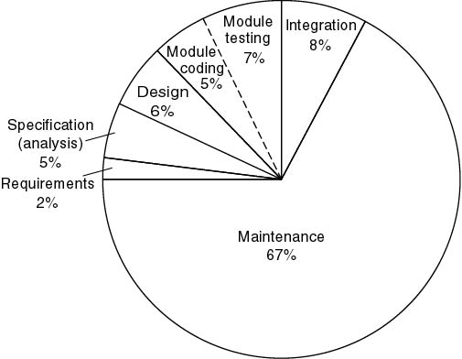
Average cost distribution
(1976–1981 data)
Object-Oriented and Classical Software Engineer 5th Edition, Schach (2002)

Slide 22
Challenges of Software Development
Complexity
Quality
Productivity
Change
Maintenance & Legacy Systems

Slide 23
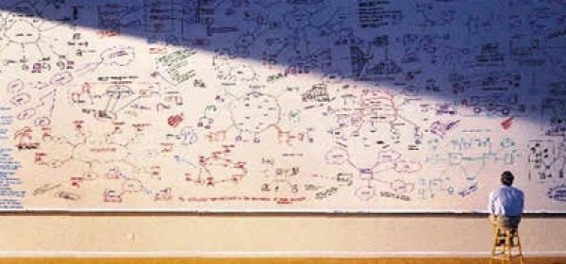
Complexity
New application domains
Systems are highly integrated
and interdependent
Different programming languages and technologies used
Different regulatory frameworks and jurisdictions
http://www.geo-viz.com/
Notes:
Software systems are deployed
for new application domains
Software systems support increasingly complex tasks
Requirements concerning functionality and efficiency are constantly growing

Slide 24
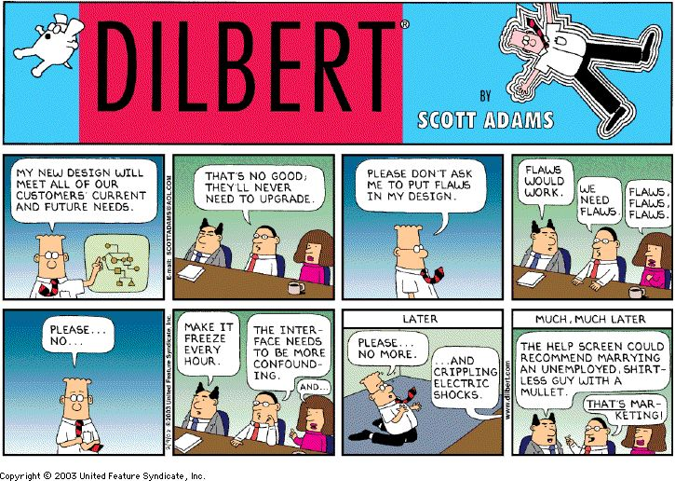
Quality
Reliability
Efficiency
Security
Maintainability

Slide 25
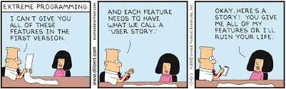
Productivity
New system
variants
The gap between demand for new or upgraded software systems and supply of HQP in Software Technologies constantly widens
Model Driven Engineering and use of “Frameworks”
Difficult to adapt standard software applications to meet every specific requirement
It is a challenge to measure productivity (LOCs/person-hour? FPs/p-m?)

Slide 26
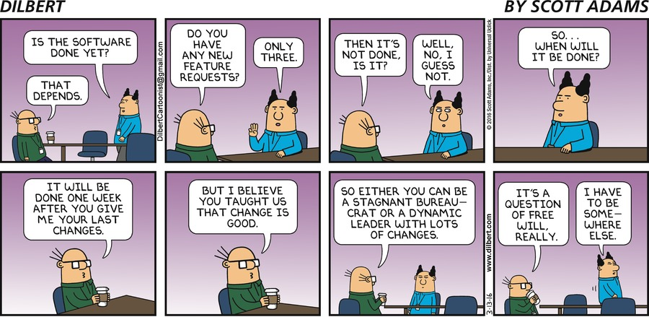
Change
Systems which have a business value and purpose need to constantly change and maintained (fix bugs, port to new platforms, add new functionality)
The “Entropy” of a software system increases with each change.
As time goes on, the cost to implement a change will be too high, and the system will then be unable to support its intended task.

Slide 27
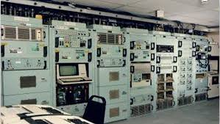
Maintenance & Legacy Systems
Maintenance
  Adaptive
  Perfective
  Corrective
  Preventive
Legacy Systems
  Long lifetime of software systems (sometimes 20 years and more)
  Software must be continuously adapted to new and changing requirements
  Maintenance of legacy systems absorbs development capacity to a high degree
  Software systems of today are the legacy of tomorrow!

Slide 28
Dealing with Complexity
Abstraction
  Modeling and Object Orientation helps
Decomposition
  Cohesion, Coupling, Modularity
Hierarchy
  Specializations, Generalizations

Slide 29
Models provide abstractions
System Model:
  Object Model: What is the structure of the system? What are the objects and how are they related?
  Functional model: What are the functions of the system? How is data flowing through the system?
  Dynamic model: How does the system react to external events? How is the event flow in the system ?
Task Model:
  PERT Chart: What are the dependencies between the tasks?
  Schedule: How can this be done within the time limit?
  Org Chart: What are the roles in the project or organization?
Issues Model:
  What are the open and closed issues? What constraints were posed by the client? What resolutions were made?

Slide 30
The Modeling Triangle
System Models
Object Model
Forward
Engineering
Reverse
Engineering
class...
class...
class...
Code
Functional
Model
Dynamic Model
Constraints
Arguments
Org Chart
Issues
Pro Con
PERT Chart
Proposals
Gantt Chart
Issue Model
Task Models

Slide 31
Decomposition
A technique used to master complexity (“divide and conquer”)
Functional decomposition (ordering of operations)
  The system is decomposed into modules
  Each module is a major processing step (function) in the application domain
  Modules can be decomposed into smaller modules
Object-oriented decomposition (agents that cause operations)
  The system is decomposed into classes (“objects”)
  Each class is a major abstraction in the application domain
  Classes can be decomposed into smaller classes

Slide 32
Hierarchy
Object oriented abstractions and decomposition lead to chunks (classes, objects) which are depicted in the object model
Another way to deal with complexity is to provide simple relationships between the chunks
One of the most important relationships is hierarchy
2 important hierarchies
  "Part of" hierarchy
  "Is-kind-of" hierarchy
Hierarchies allow for inheritance of code and features from one chunk to another below in the hierarchy

